Slide 1



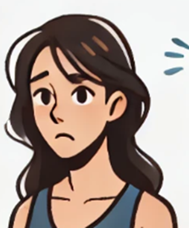



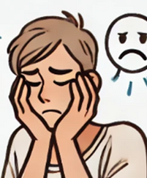


Facts, Not Feelings
Notes:
We are going to be talking about facts not feelings.
Ask: What does facts not feelings mean to you? What could be a benefit of focusing on facts rather than feelings?
While feelings have their place in the work environment when it comes to developing and growing within the workplace facts should prevail. Focusing on facts not only in the workplace but in your personal life has so many benefits. Often times we can have strong feelings about a situation that stops us from making good choices. This can lead to knee jerk reactions or situations to escalate to become an HR case. We want to avoid this by learning why the facts are important and how control our feelings.

Slide 2

What Is A Feeling?
Feelings are subjective; they are an emotional state or reaction.
Notes:
Before we go into how to focus on facts and controlling our feelings its important to know what a facts is. A fact is supported by one or more shreds of evidence. A fact is true and correct for everyone no matter what. For the most part a fact should not be up for debate. If I tell you water freezes at 32 degrees that would be a fact.

Slide 3




It can be hard to tell the difference between facts and feelings, especially when we are feeling strong emotions.
Emotions are personal and shaped by our beliefs, experiences, and culture. They guide how we respond and relate to others but can also be irrational and easily influenced.
Notes:
It can be hard to tell the difference between facts and feelings, especially when we are feeling strong emotions. Even though feelings don’t last forever and can change from person to person, they can seem so real that we think they must be true. Emotions are deeply personal and subjective experiences encompassing feelings like happiness, sadness, anger, and fear. They are shaped by our perceptions, beliefs, past experiences, and cultural backgrounds, making each person’s emotional experience unique. Emotions influence our responses to various situations and how we engage in social interactions. They offer valuable insights about ourselves and our surroundings but can also be irrational and easily sawyed.

Slide 4


Embrace the power of facts while acknowledging and managing emotions to create a thriving workplace culture.
Feelings are crucial when building a team and creating a positive work environment.
Notes:
Its important to validate our coworkers feelings and be empathetic towards their feelings. Facts not feelings is not saying your feelings don’t matter but rather finding the balance. Focusing on facts is difficult when we are stuck in our feelings.

Slide 5


What Is A Fact?
The truth about events as opposed to interpretation.
Notes:
Before we go into how to focus on facts and controlling our feelings its important to know what a facts is. A fact is supported by one or more shreds of evidence. A fact is true and correct for everyone no matter what. For the most part a fact should not be up for debate. If I tell you water freezes at 32 degrees that would be a fact.

Slide 6



Why Do Facts Matter?
Focusing on facts reduces conflicts and misunderstandings.
Facts provide a clear picture of what is true.
Make decisions based on logic, rather than feelings, and personal opinions.
Notes:
Its important to focus on the facts. No matter the situation facts should prevail. Make decisions based on logic. Don’t let feelings to change your opinion or decision. What happens when we make decisions based on feelings?

Slide 7


Activity: Facts and Feelings
Identify if each of the statements are a facts or feeling.
“John missed three deadlines this month.”
“I feel like
John is unreliable.”
“The customer provided negative feedback about the service.”
“It seems like the customer didn’t like me.”
FACT
FEELING
FACT
FEELING
Facts become feelings when personal opinions and biases are involved.
Notes:
Each of these statements are either a fact or a feeling. Take about one minute to write in on the activity sheet whether the statement is a fact or feeling.
Read the statement after the minute. Answers are on a clicker.
On a clicker at the end: Facts are impacted by feelings Facts become feelings when personal opinions and biases are involved.

Slide 8
Gather
All The Facts
Who
What
Identify the people directly involved in the situation.
Describe the situation that took place.
Use the four W’s to identify key details and essential elements; avoid opinions or interpretations.
Where
When
Specify where the situation took place.
Specify the time, day, month, and year the situation occurred.
Notes:
When feelings get involved its easy to lose focus of all the facts.

Slide 9

Why Not The Why?
When identifying key details, the focus is not on the “why,” as it is open to personal feelings and speculation.
Asking “why” often leads to defensiveness and emotional responses.

Slide 10
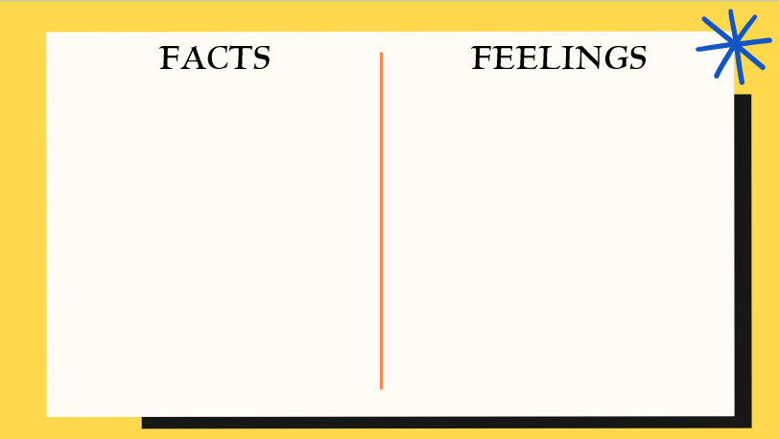
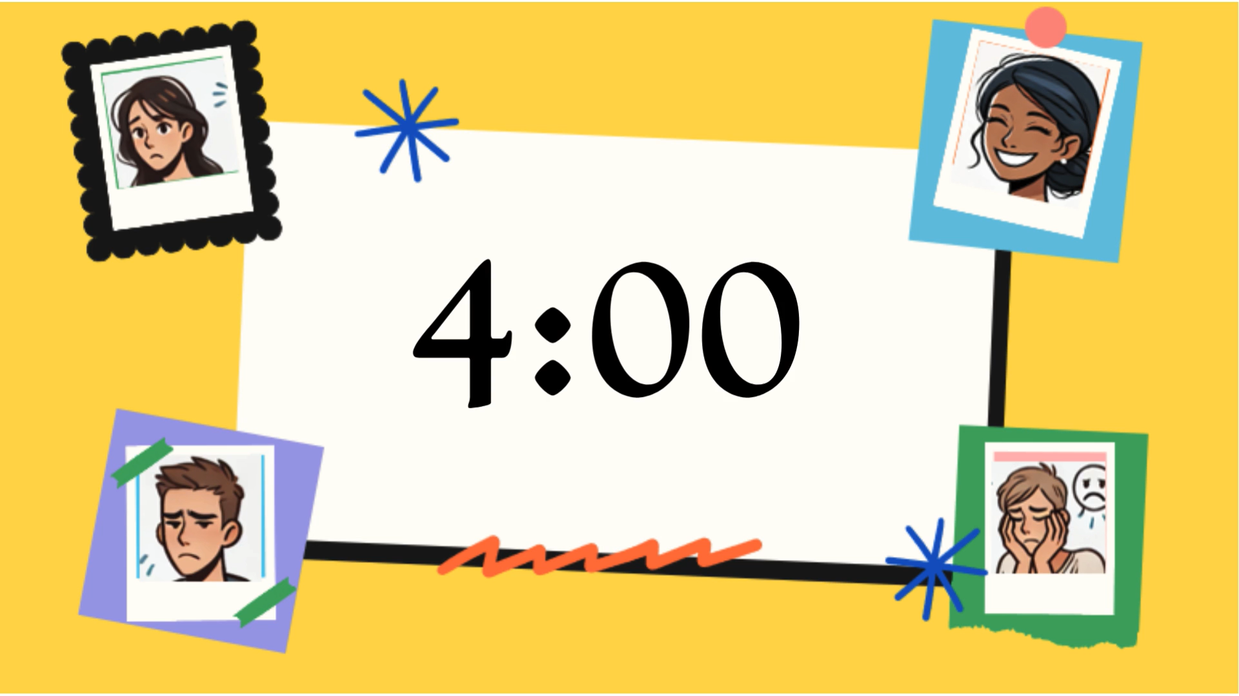


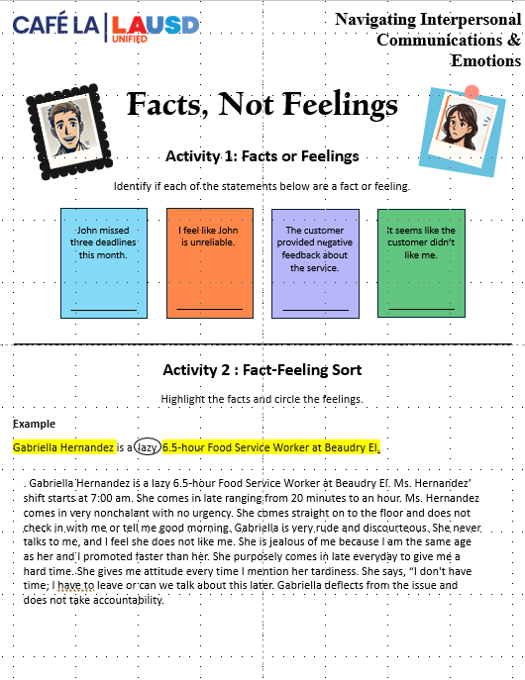

Activity: Fact-Feeling Sort
Gabriella Hernandez
Saying, “I don’t have time; I have to leave,” or “Can we talk about this later?”
Whenever I address her tardiness, she responds with an attitude.
lazy
Highlight the facts and circle the feelings.
6.5-hour Food Service Worker at Beaudry Elementary.
She appears nonchalant and lacks sense of urgency.
Example:
Gabriella Hernandez is a lazy 6.5-hour Food Service Worker at Beaudry El.
She dismisses the issue
Ms. Hernandez’s shift starts at 7:00 am but she frequently arrives late ranging from 20 minutes to an hour.
Is often rude and discourteous.
Deflects responsibility and refuses to take accountability for her actions.
I feel that she dislikes me.
Upon arrival, she goes straight to the floor without checking in with me or greeting me “Good Morning.”
I believe she is jealous of me because we are the same age, yet I was promoted faster than she was.
Gabriella
She deliberately arrives late everyday to make my job difficult.
She never speaks to me
Notes:
We will be looking at a scenario of how feelings can cloud our focus causing us to have personal opinions and react in a negative way.
Activity Read the paragraph out loud convey tone and feeling. Have the group follow along. Use the highlighter to highlight any facts circle any feelings.
2-minute timer starts automatic when clicked over.

Slide 11

Be self aware of your feelings and their effect on others. Feelings impact communication, teamwork, and the work environment.
The Sr. FSW and FSW are always arguing and the whole team can hear.
A coworker is friendly and positive every morning.
Anger
Happy
A coworker gets frustrated and complains when there is any change.
The FSM is excited when there is a new recipe.
Frustrated
Excited
Notes:
Let's talk about it. How can these situations effect communication, teamwork, and workplace dynamic.
Read the statement:
Ask: What emotion does this express? How would this effect the work environment?
How do you think different types of emotions impact workplace culture? If you have a Sr. FSW that’s always arguing how does that impact communication? Will the Sr. be as approachable? If a coworker is friendly and happy every morning, are they going to create a positive work environment? A coworker gets frustrated and complains when there is any change can this effect teamwork?

Slide 12


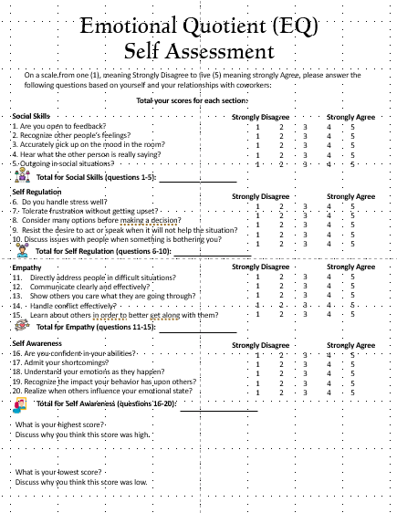

Activity 3
Emotional Quotient
Self Assessment
Notes:
You’ve heard of Intelligence Quotient this is Emotional Quotient. This assessment assess self regulation skills, communication skills, social skills, level of empathy and how self aware you are overall. Allow 5 minutes for attendees to complete the assessment. Allow another 2 minutes if someone would like to share or ask questions. Would anyone like to share? Do you feel its accurate? Maybe those are areas we can work on? Part of self awareness is understanding ourselves. We are all different and that’s okay we have our strengths and weaknesses.

Slide 13

Communicate from a helpful constructive place without diminishing the other person.

Slide 14
We cannot control what happens, but we can control our reactions.
Focus
On What We Can Control
Notes:
Feelings are a subjective emotional response to a situation, Although feelings are valid, they can change from one person to another from situation to situation. What one person feels strongly about another person may not feel the same or so strongly. feelings are how you experience something personally. We may not always be able to control our feelings but its important to be self aware about our feelings to be able to process them in a positive way and learn to control our reactions to those feelings. while we can’t stop emotions from showing up, we can choose how we respond.

Slide 15

Practice Self Reflection
Look inwards and understand your moods and emotions and their effect on others.
  Communicate with empathy
  Recognize your strengths and weaknesses
  Be aware of how you interact with others
  Be able to self regulate
Notes:
One is self aware when they can pinpoint what they are feeling and why

Slide 16

Share and read aloud the “NICE Nuggets” poster with your staff. Post in a visible area for your staff to review as they please.

Slide 17
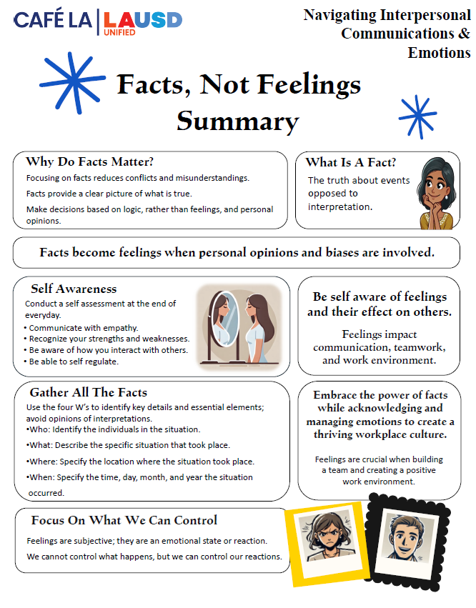
Thank
You
Please enjoy the summary handout and retain throughout the NICE Workshop program in your 3-ring binder
Notes:
We are going to be talking about facts not feelings in the workplace. How many of you heard this term before? While feelings have their place in the work environment when it comes to developing and growing within the workplace facts should prevail.

